Slide 1

Complex Data Using ASF
Indian Institute Of Technology, Bombay
For Prayagraj (B)
Student Name: Riya Sunil Kharade
Guided BY : Prof. Gulab Singh
Subject : Microwave Satellite Data Processing

Slide 2
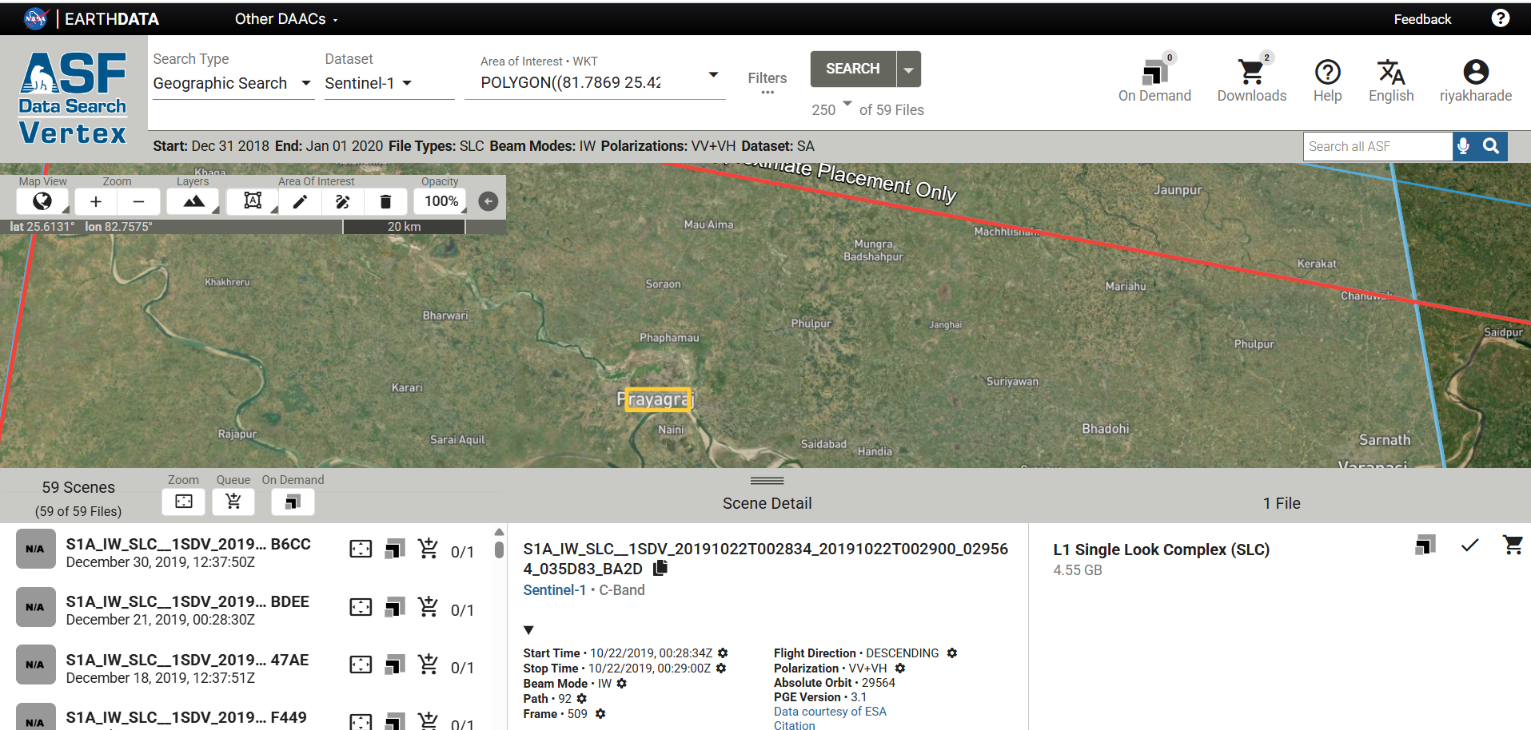
Data Downloading Using ASF for Prayagraj

Slide 3
Import S1 A Data /S1 Tops- Split
Drag and Drop folder

Slide 4
Step 1: Apply Arbit File
Radar-Apply Arbit File-Run

Slide 5
OUTPUT

Slide 6
Step 2: Split
Radar-Sentinel 1 TOPS – S1 TOPS Split

Slide 7
OUTPUT

Slide 8
Step 3: Calibration
Radar-Radiometric-Calibration

Slide 9
OUTPUT

Slide 10
Step 4: Deburst
Radar-Sentinel 1 TOPS- S1 TOPS Deburst

Slide 11
OUTPUT

Slide 12
Step 5: Matrix
Radar-

Slide 13
OUTPUT

Slide 14
Step 6: Multilooking
Radar-SAR Utilities-Multilooking

Slide 15
OUTPUT

Slide 16
Step 7: Speckle Filtering
Radar-

Slide 17
OUTPUT

Slide 18
Step 7:Range-Doppler Terrain Correction
Radar-Geometric-Terrain Correction-Range Doppler Terrain Correction

Slide 19
OUTPUT

Slide 20
Step 8: RGB Image Window
Right Click On TC file-Open RGB Image Window

Slide 21
OUTPUT

Slide 22
Step 9: Calculate PC,PV,PG
Use Build Maths
PC=FC=2 |IMG (C12)|
PV=FV=2(2*C22-PC)
PG=FG=C11-3/4*PV-PC/2
PC for RED
PV for Green
PG for Blue

Slide 23
Step 10: Classification (Supervised)

